Slide 1
SUPER-MARKET BILLING PROGRAM USING LOOPS (PYTHON)

Slide 2
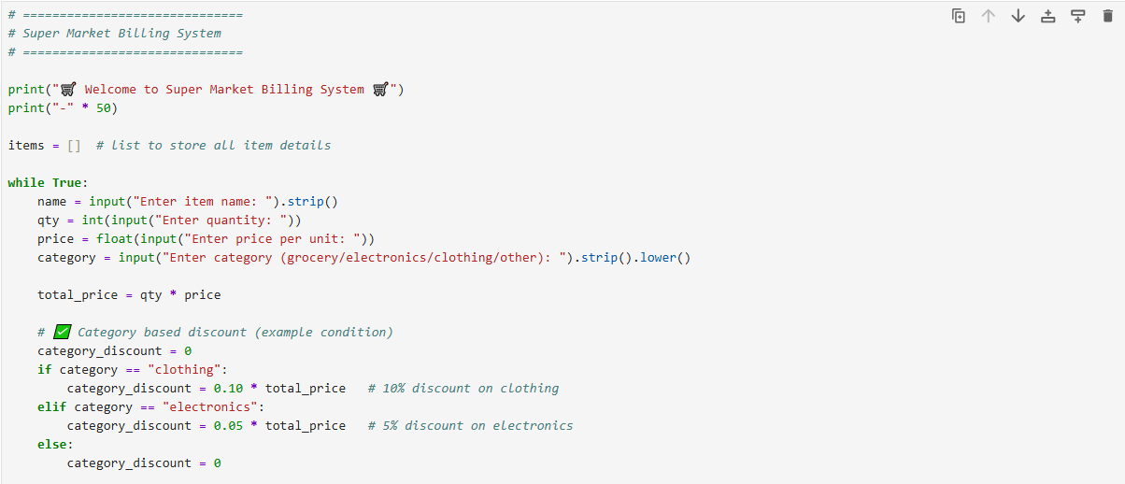

Slide 3
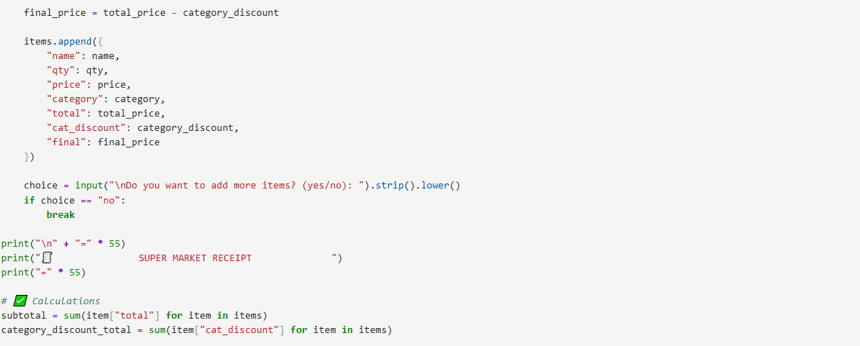

Slide 4
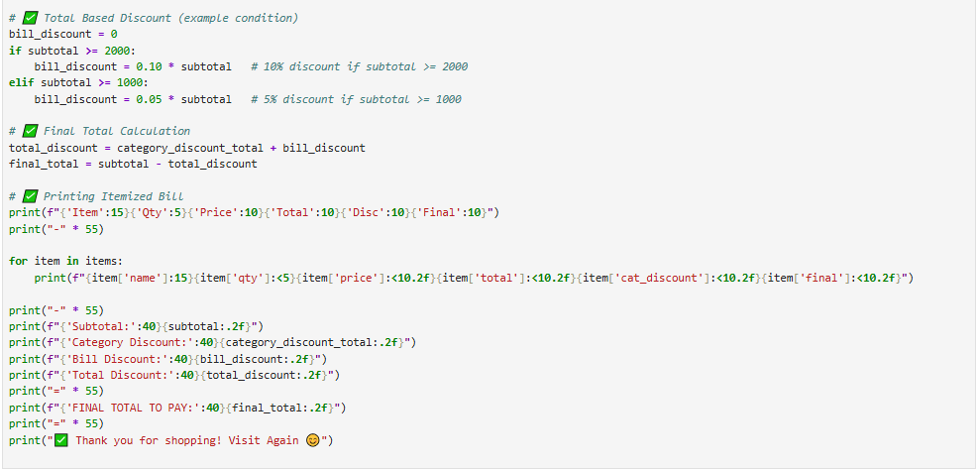

Slide 5
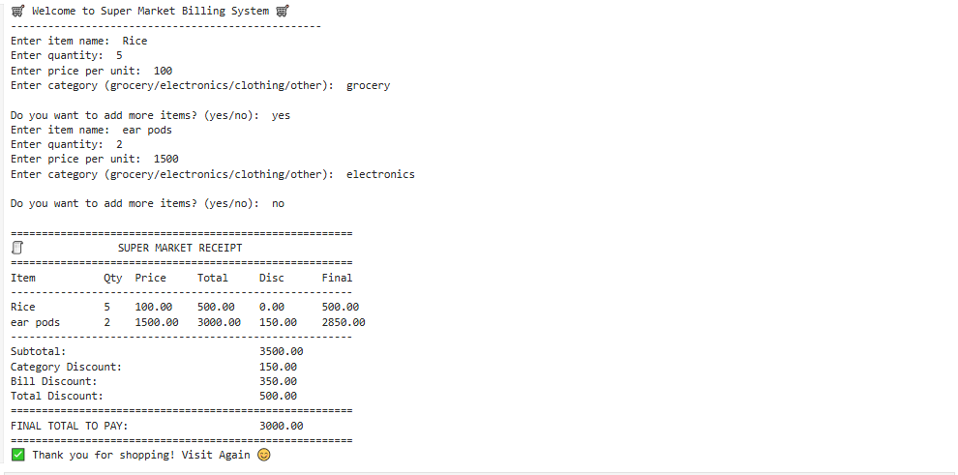

Slide 6
THANK YOU

